Slide 1
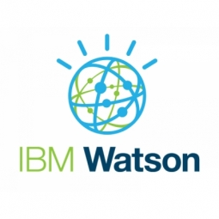
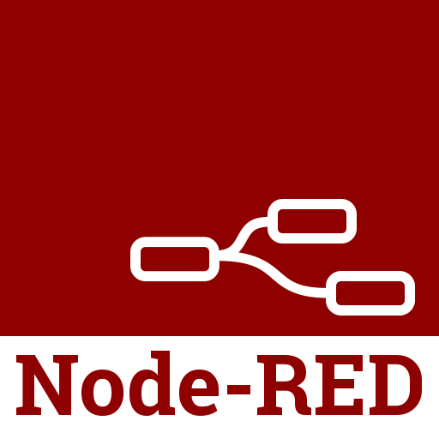
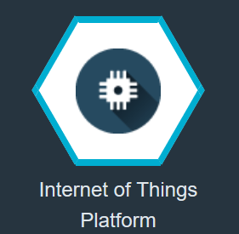
Smart Agriculture System based on IoT
Block Diagram:
Web App
IBM WATSON Cloud Platform
Node-Red
IBM IoT Simulator
Weather Data Using API
IoT IBM Platform
Motor ON /OFF

Slide 2
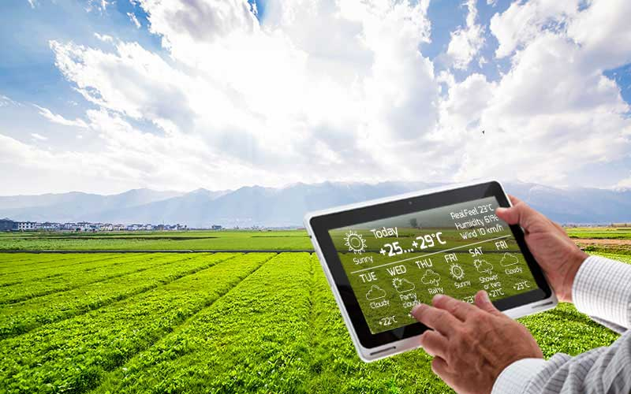
Overview
The world population is increasing at a daunting pace. However, due to the increasing population, the old and traditional farming methods are proving insufficient for providing food in bulk quantities. Farmers working in the farm lands are solely dependent on the rains and bore wells for irrigation of their land.
This project involves building a smart IOT based agriculture system to monitor the weather conditions and soil conditions and help the farmer to gain better yield. It also helps farmer to avoid the problem of over irrigation and under irrigation.
With the help to this, the productivity of crops can be maximized at minimal cost.

Slide 3
Smart Internz Dashboard
Very helpful tool to track the progress of your intern.
Here you can see your project details with some milestones in Project Details tab. These milestones provide details about tasks which you have to complete.
You can track your task progress and move the tiles into review tab once they were completed. They moved into complete tab when reviewed by mentor.
In Mentor Review tab, tasks are placed which has been reviewed by mentor.
Also there are links of Git repository, Zoho Writer in which you can prepare your report and there is link for Slack channel through which you can interact and solve your doubts with mentor or other team members.

Slide 4
IBM Cloud and Node-red
IBM Cloud is a set of cloud computing services for business offered by the information technology company IBM.
We used IBM cloud for online IOT platform which provide temperature, humidity and object temperature through IOT sensor and also processes the data.
Also we use cloud with python programming control the motors.
We can make devices on cloud, make API keys to use them in third party platforms, add team members, assign them roles, control their accessibility, track data in real time with help of boards and cards.
Node-RED is a programming tool for wiring together hardware devices, APIs and online services in new and interesting ways.
It is used to create web apps and user interfaces through which users can interact with the Cloud and regulate the motors.

Slide 5
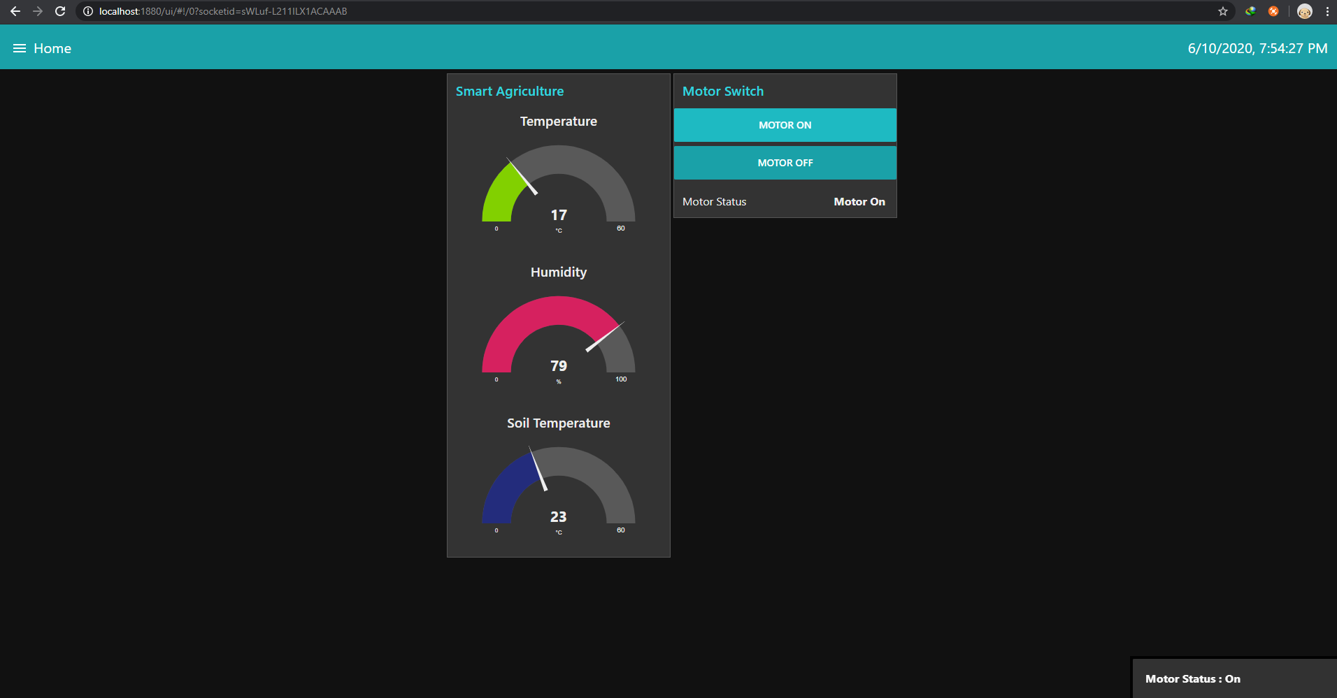
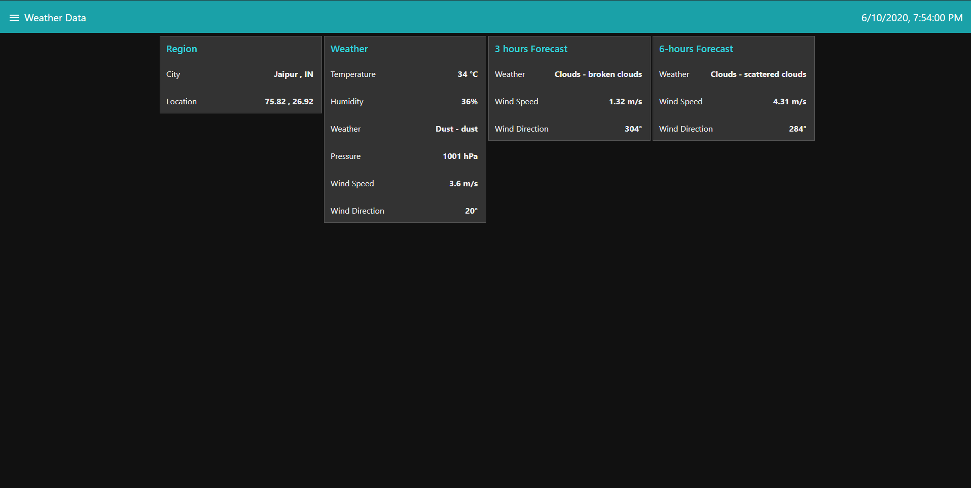
Tab showing the region, weather forecast, and upcoming forecast on Node-red UI
Tab showing Home page in which temperature, humidity, soil temperature and motor controls are given.

